Slide 1
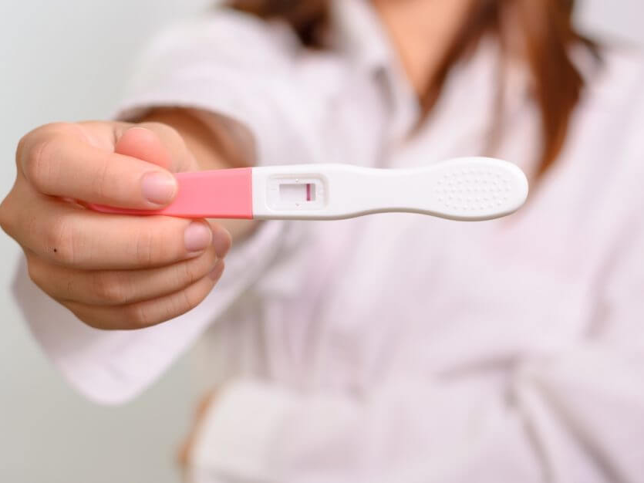
Hepatic Lipase Deficiency
and Infertility
Jessica Thornton
Notes:
Add UW logo

Slide 2
What is Hepatic Lipase Deficiency?
Notes:
Maybe add in specific mutations?

Slide 3
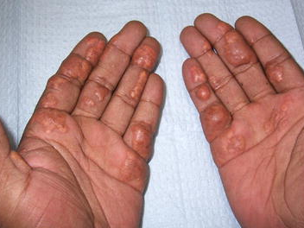
Hepatic Lipase Deficiency Symptoms
Notes:
Xanthomas
https://media.springernature.com/original/springer-static/image/art%3A10.1007%2Fs11552-009-9206-7/MediaObjects/11552_2009_9206_Fig1_HTML.jpg

Slide 4
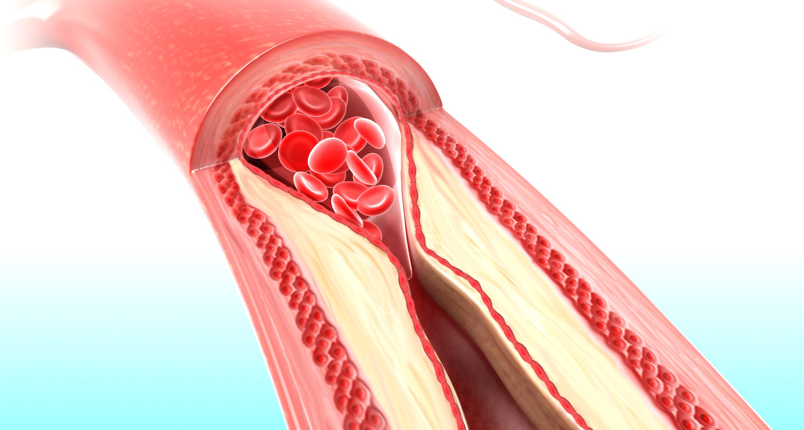
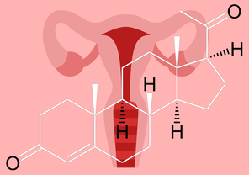
Hepatic Lipase Deficiency Complications

Slide 5
What causes Hepatic Lipase Deficiency?
Notes:
Maybe add in specific mutations?

Slide 6
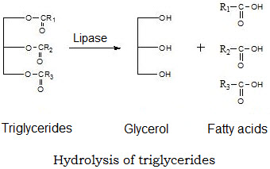
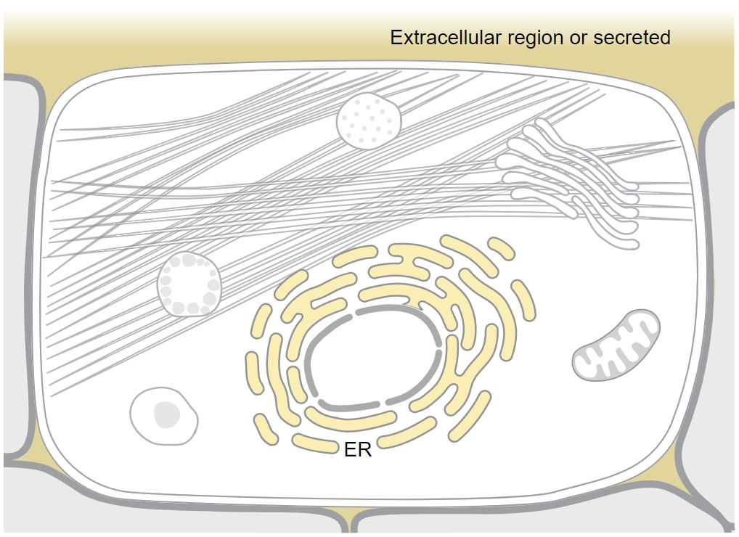
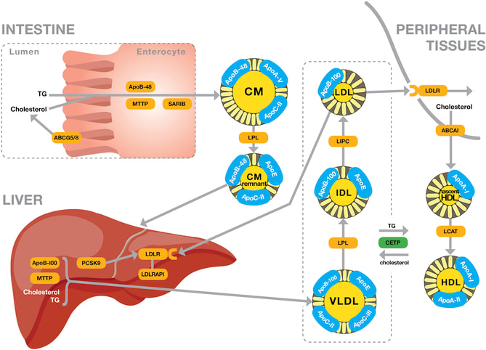
What does LIPC do?
Molecular Function
Cellular Component
Biological Process

Slide 7
LIPC has a complicated evolutionary history
Notes:
LIPC is well-conserved across multiple species, but duplication events have complicated functional similarities
This is a small sample of all the related lipases in the human genome/proteome

Slide 8
Hepatic Lipase Deficiency Complications

Slide 9
Hepatic Lipase Deficiency Complications

Slide 10
Hepatic Lipase Deficiency Complications
via progesterone?

Slide 11
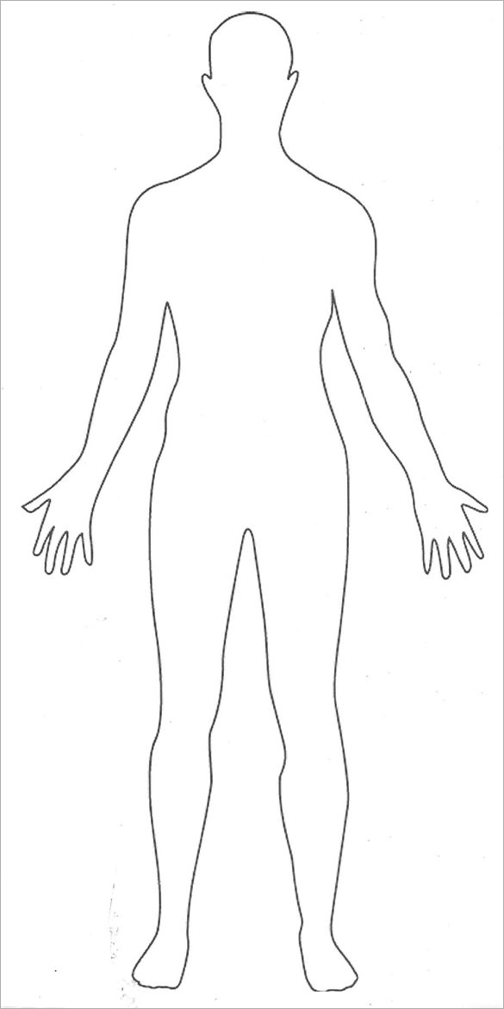
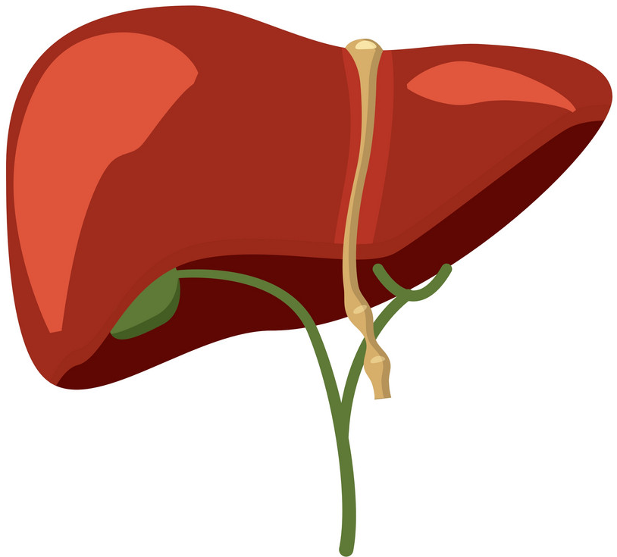
Where is LIPC expressed?
Notes:
Exons 1+2= 90aa

Slide 12
Where is LIPC expressed?
Notes:
Exons 1+2= 90aa

Slide 13
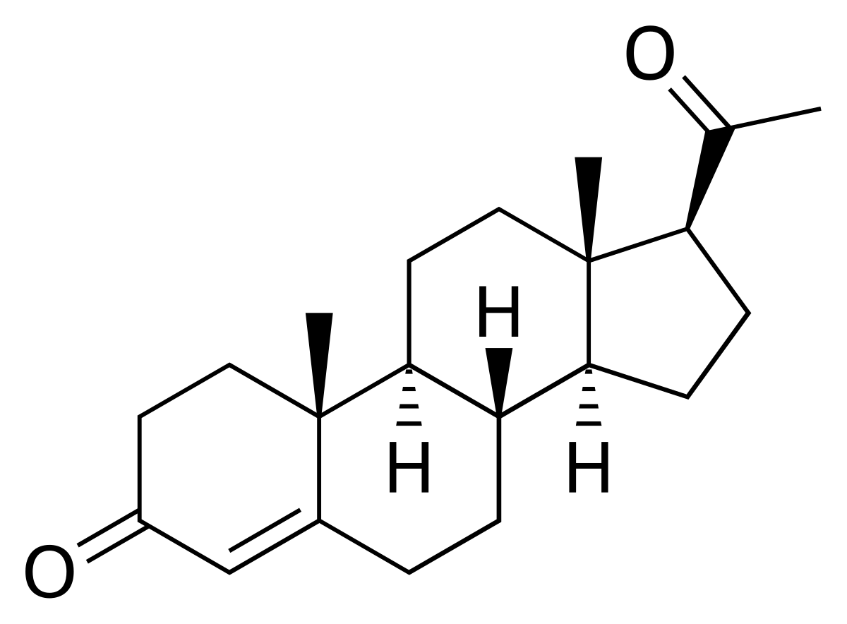
How does lipid metabolism affect fertility?
Progesterone

Slide 14
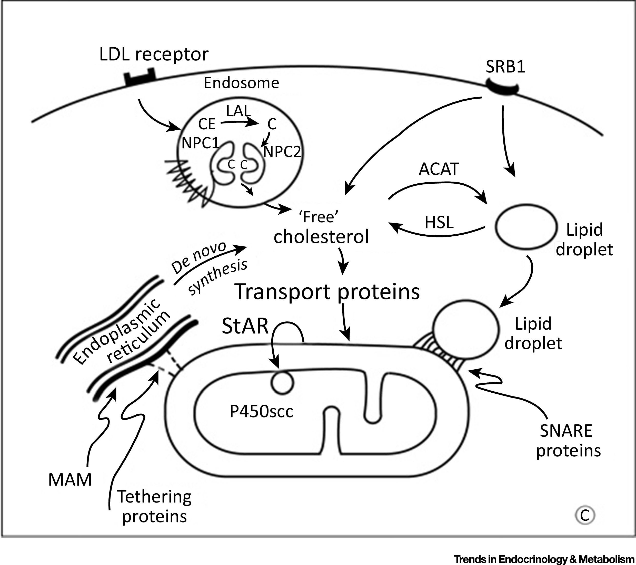
How is cholesterol used in progesterone synthesis?
IDL
LDL
1
LIPC
(SREBF1)
(LIPA)
(SOAT1)
(LIPE)
3
2
Progesterone Synthesis

Slide 15
What role does LIPC play in progesterone synthesis?
IDL
LDL
LIPC
Interacts With
Catalyzes Step

Slide 16
LIPC may free intracellular cholesterol
IDL
LDL
Full Length LIPC
Truncated LIPC
Progesterone Synthesis

Slide 17
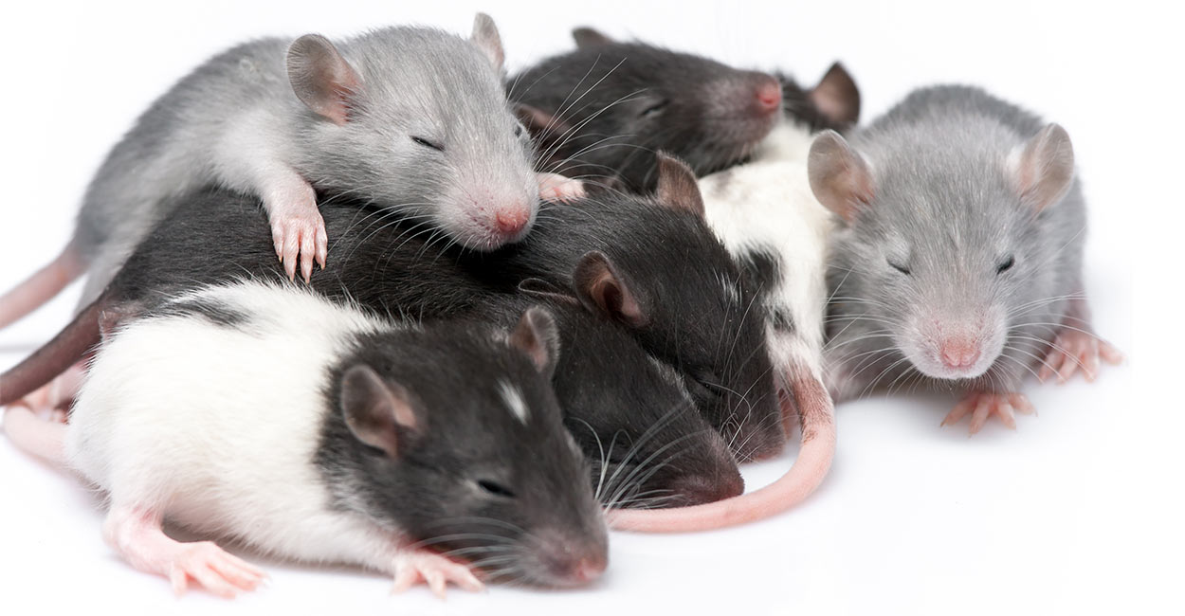
How can we study LIPC?
Notes:
Study HLD’s effect on reproduction using rats.
Rat granulosa cells have the same preferences for cholesterol substrates as humans.
Progesterone levels can be checked by blood test.
Combination of human cell culture and live rat models.

Slide 18
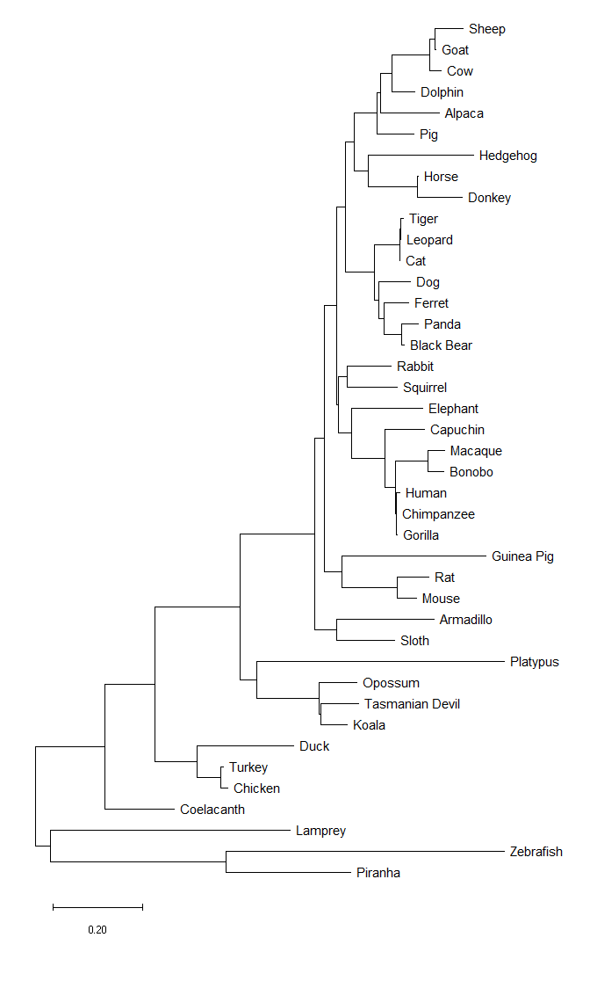
Why are rats good for studying LIPC?
Notes:
Study HLD’s effect on reproduction using rats.
Rat granulosa cells have the same preferences for cholesterol substrates as humans.
Progesterone levels can be checked by blood test.
Combination of human cell culture and live rat models.

Slide 19
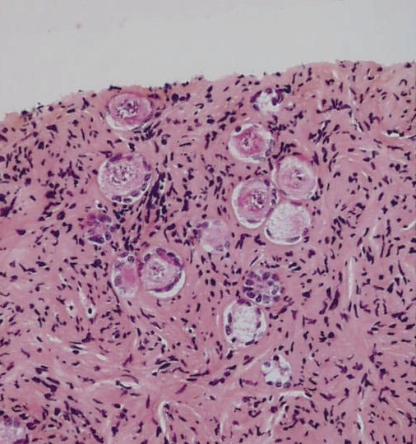
How can we study LIPC?
Notes:
Combination of cell culture (Chinese Hamster Ovarian cells) and live rat models.

Slide 20
AIM 1: Domain analysis of exons 1 and 2
Domain Analysis
Mutagenesis
Biochemical Assays
Notes:
Blasted LIPC and found 3 conserved glycosylation sites in exons 1 and 2 (N42, N56, N78).

Slide 21
AIM 1: Domain analysis of exons 1 and 2
Domain Analysis
Mutagenesis
Biochemical Assays
Notes:
Blasted LIPC and found 3 conserved glycosylation sites in exons 1 and 2 (N42, N56, N78).

Slide 22
AIM 1: Domain analysis of exons 1 and 2
Domain Analysis
Mutagenesis
Biochemical Assays
Notes:
Blasted LIPC and found 3 conserved glycosylation sites in exons 1 and 2 (N42, N56, N78).

Slide 23
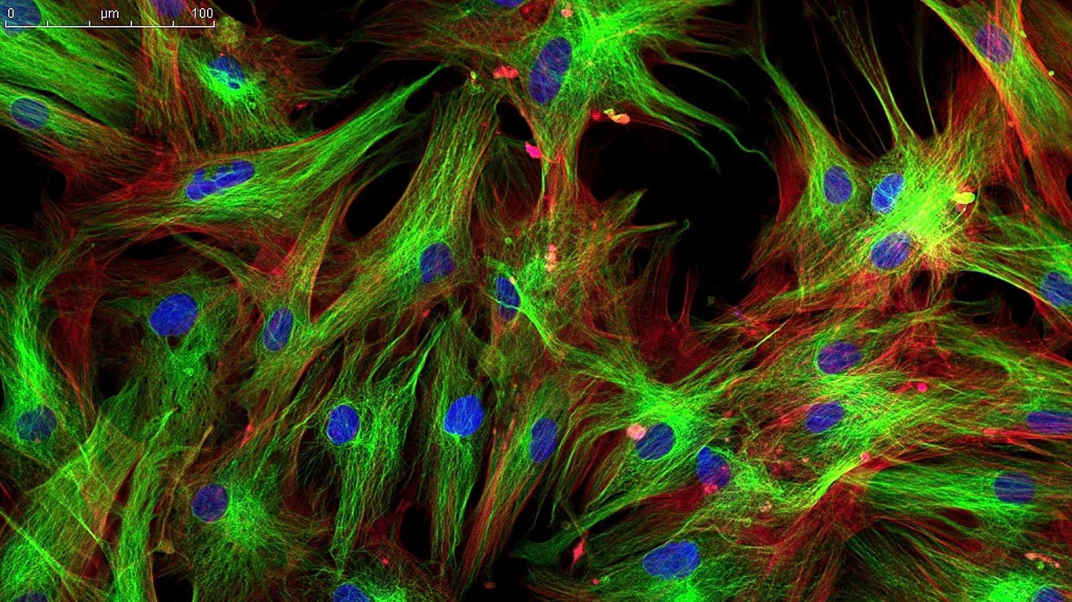
AIM 1: Domain analysis of exons 1 and 2
Domain Analysis
Mutagenesis
Biochemical Assays
Notes:
Blasted LIPC and found 3 conserved glycosylation sites in exons 1 and 2 (N42, N56, N78).

Slide 24
AIM 2: Altered gene expression with LIPC isoforms
Change in LIPC activity or progesterone levels
LIPC Mutant Rats
RNA-seq
GO Analysis

Slide 25
AIM 2: Altered gene expression with LIPC isoforms
LIPC Mutant Rats
RNA-seq
GO Analysis

Slide 26
AIM 2: Altered gene expression with LIPC isoforms
Wildtype
Full Length LIPC Only
Truncated LIPC Only
LIPC Mutant Rats
RNA-seq
GO Analysis

Slide 27
AIM 2: Altered gene expression with LIPC isoforms
Molecular Function
Cellular Component
Biological Process
Downregulated
Upregulated
LIPC Mutant Rats
RNA-seq
GO Analysis

Slide 28
AIM 3: Protein Interactions of LIPC Isoforms
Wildtype
Full Length LIPC Only
Truncated LIPC Only
LIPC
LIPC
LIPC Mutant Rats
TAP-MS
Network Analysis

Slide 29
AIM 3: Protein Interactions of LIPC Isoforms
Wildtype
Full Length LIPC Only
Truncated LIPC Only
LIPC
LIPC
LIPC Mutant Rats
TAP-MS
Network Analysis

Slide 30
AIM 3: Protein Interactions of LIPC Isoforms
Wildtype
Full Length LIPC Only
Truncated LIPC Only
LIPC
LIPC
LIPC Mutant Rats
TAP-MS
Network Analysis

Slide 31
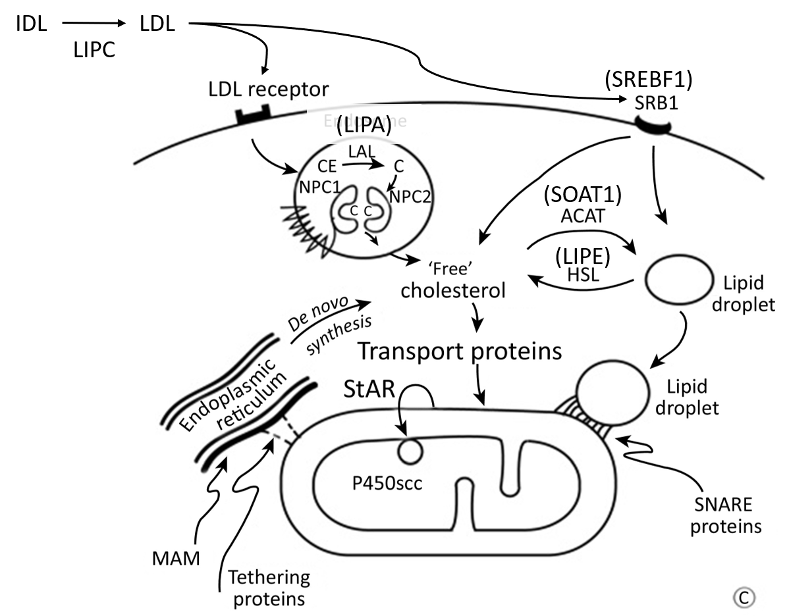
Future Directions
1
DRUGS
2
Progesterone Synthesis

Slide 32
Future Directions
1
DRUGS
2
Progesterone Synthesis

Slide 33
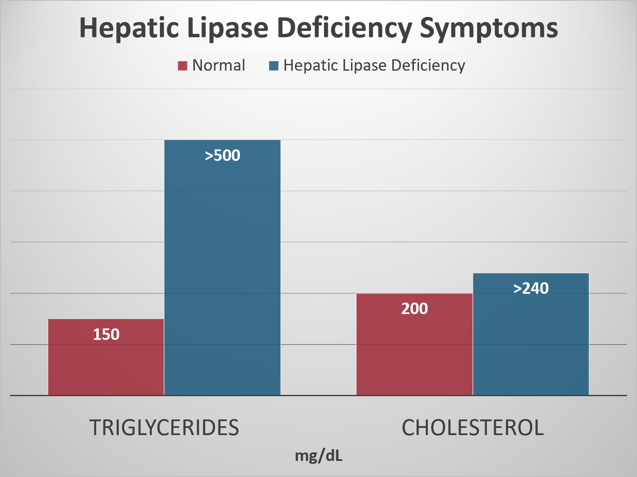
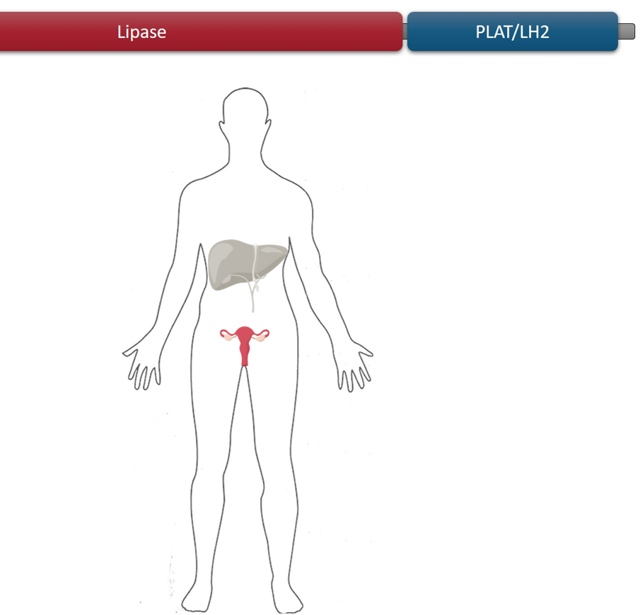
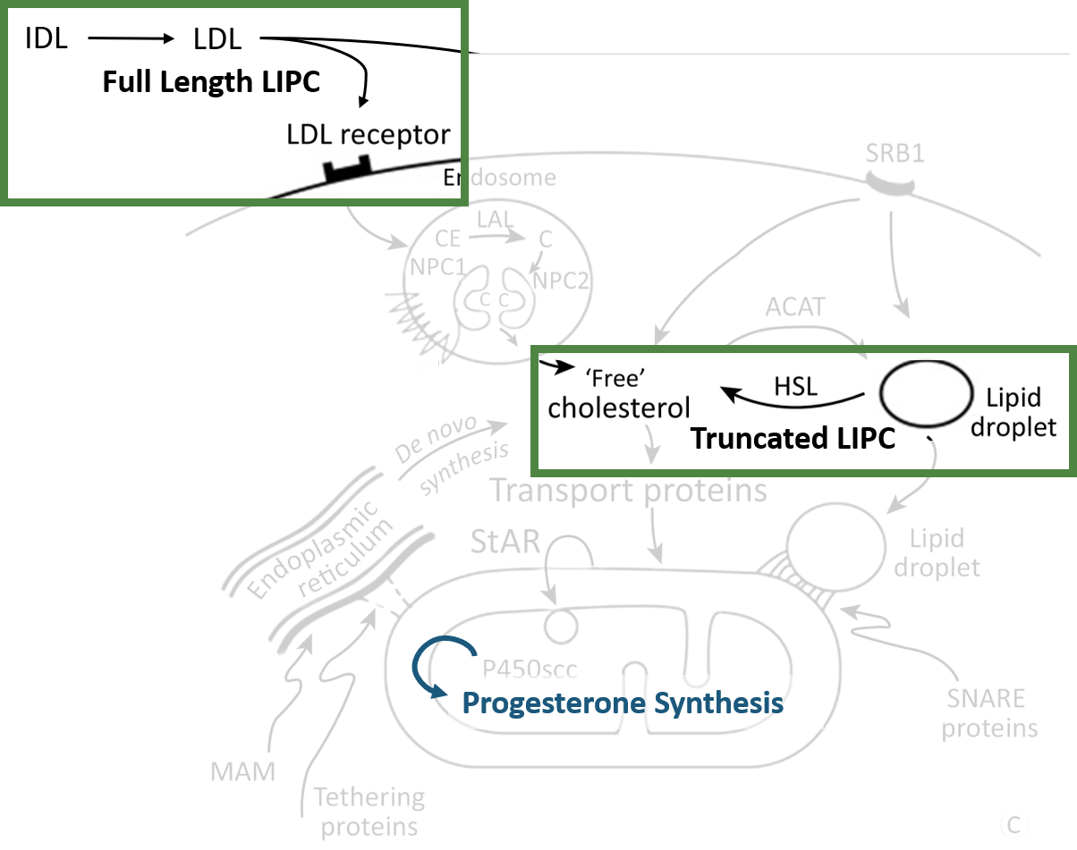
Summary
Hepatic Lipase Deficiency (HLD) is caused by mutations in LIPC.
Mutations in LIPC may also lead to reduced fertility.
Understanding LIPC involvement in reproduction can help treat HLD patients.

Slide 34
References
[1] https://www.suppreviewers.com/ingredients/lipase/
[2] https://www.uniprot.org/uniprot/P11150
[3] https://www.sciencedirect.com/science/article/pii/S0031302518305713#fig1
[4] https://www.everydayhealth.com/type-2-diabetes/diet/can-eating-too-much-sugar-cause-diabetes/
[5] https://thecostaricanews.com/know-low-progesterone/
[6] https://www.gutmicrobiotaforhealth.com/en/bacterial-butyrate-prevents-atherosclerosis-by-maintaining-gut-barrier-function-in-mice/
[7] https://www.cell.com/trends/endocrinology-metabolism/fulltext/S1043-2760(17)30113-3
[8] https://squeaksandnibbles.com/baby-rats/
[9] https://www.researchgate.net/figure/In-vitro-culture-of-human-ovarian-tissue-a-Freshly-collected-and-fixed-ovarian-tissue_fig7_11494863
[10] https://www.nature.com/articles/nbt0510-421

