Slide 1
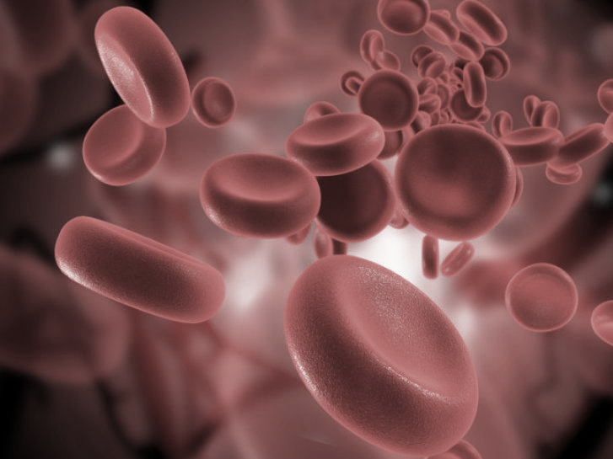
Hepatic Lipase Deficiency
Jessica Thornton

Slide 2
What is Hepatic Lipase Deficiency (HLD)?
Lipid | Normal Levels | Borderline High Levels | High Levels
Triglycerides | <150 mg/dL | 150 - 199 mg/dL | ​>500 mg/dL
Cholesterol | <200 mg/dL | 200 - 239 mg/dL | >240 mg/dL

Slide 3
What causes Hepatic Lipase Deficiency?
Notes:
Maybe add in specific mutations?

Slide 4
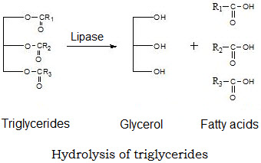
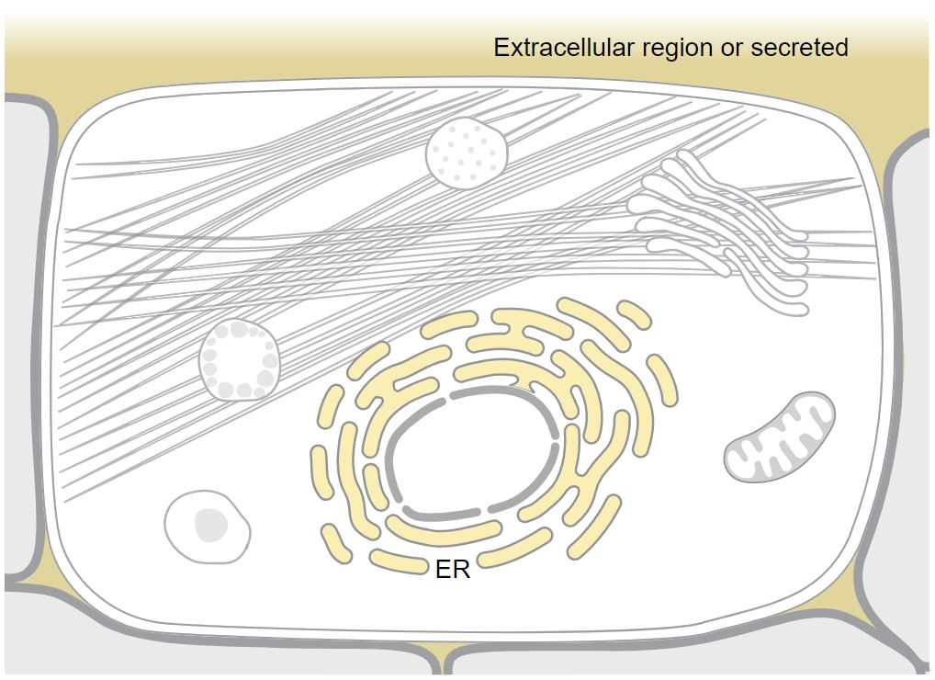
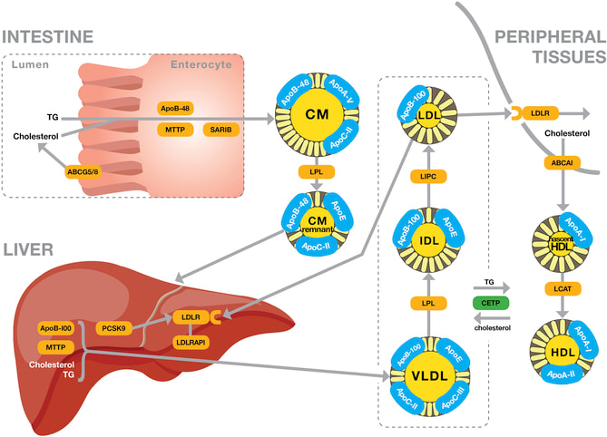
What does Hepatic Triacylglycerol Lipase do?
Molecular Function
Cellular Component
Biological Process

Slide 5
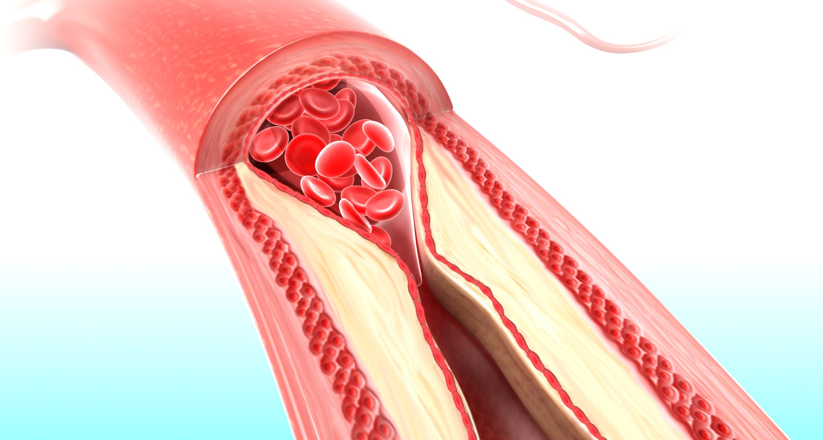
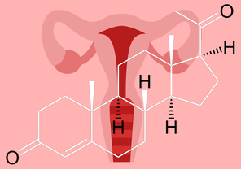
What complications can occur because of hepatic lipase deficiency?

Slide 6
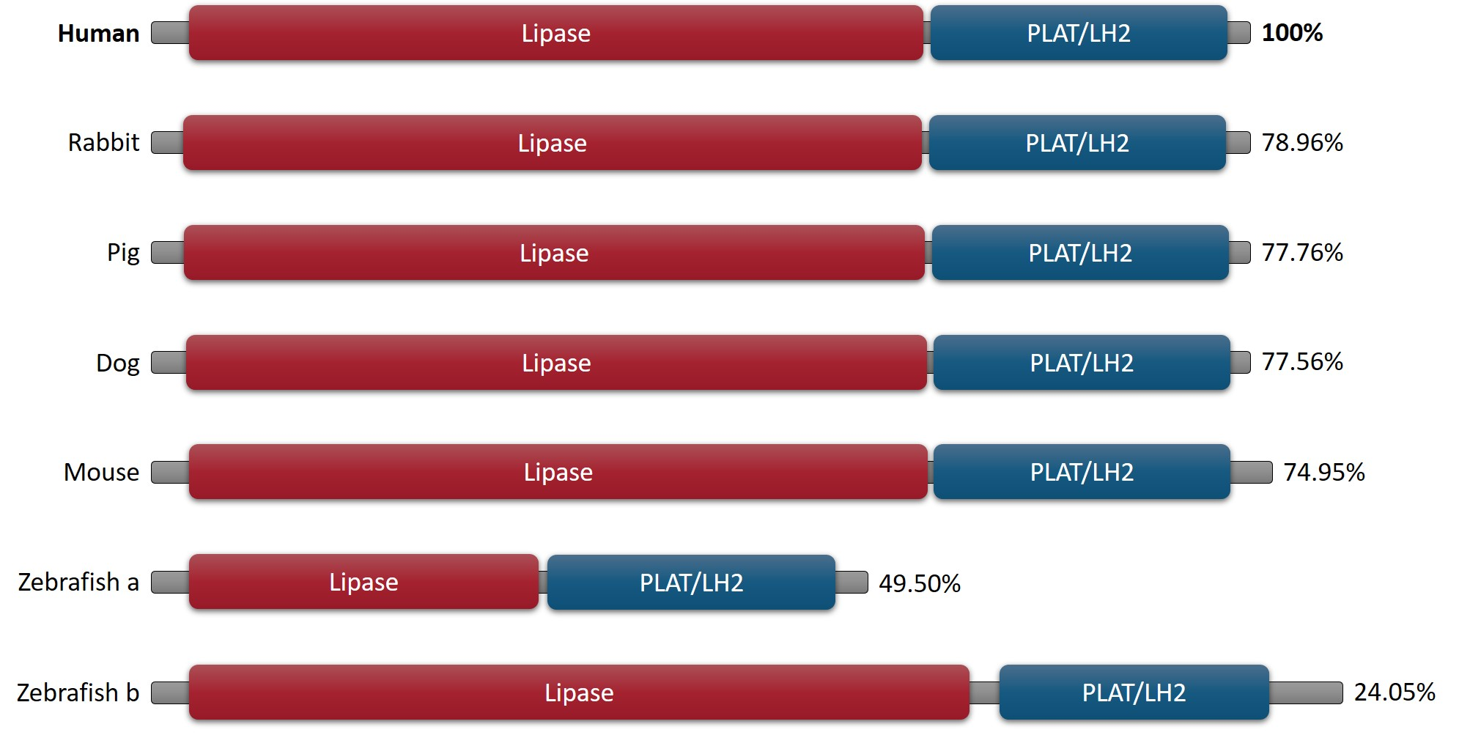
How conserved is LIPC across model organisms?
Notes:
Will add rats to figure

Slide 7
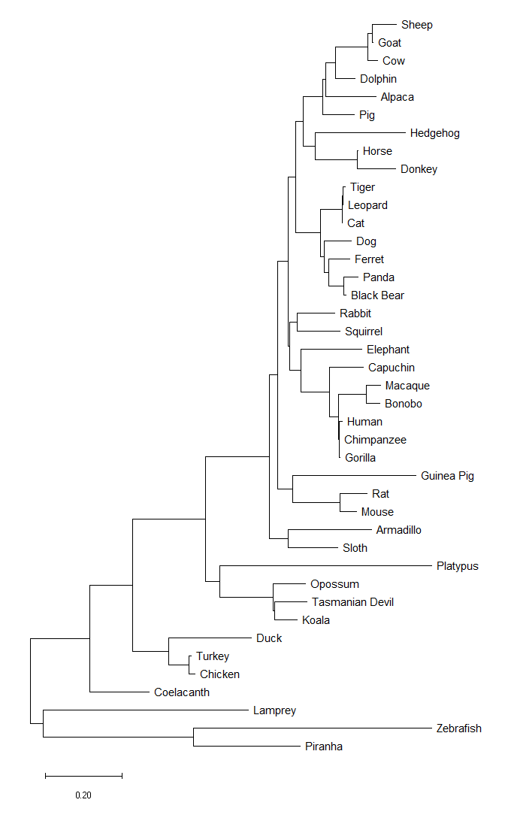
How closely related are these orthologs?

Slide 8
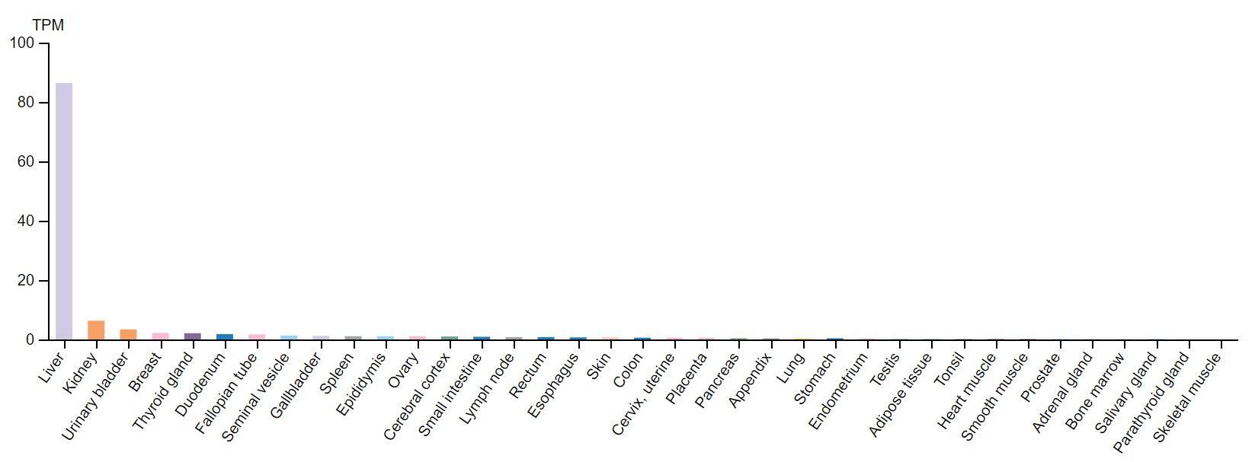
Where is LIPC expressed?

Slide 9
Where is LIPC expressed?

Slide 10
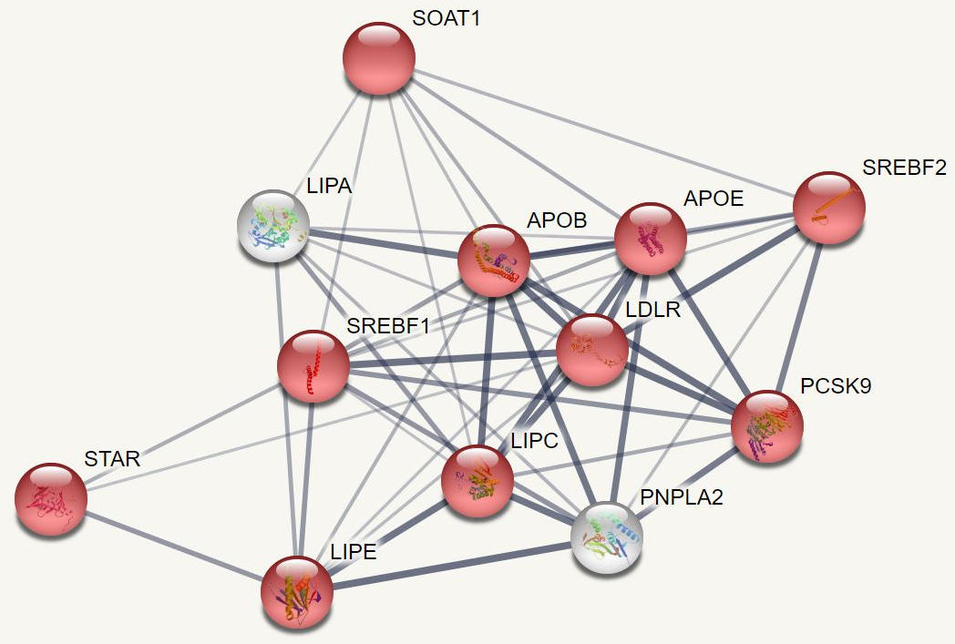
How is LIPC involved in cholesterol homeostasis?

Slide 11
How is LIPC involved in progesterone synthesis?

Slide 12
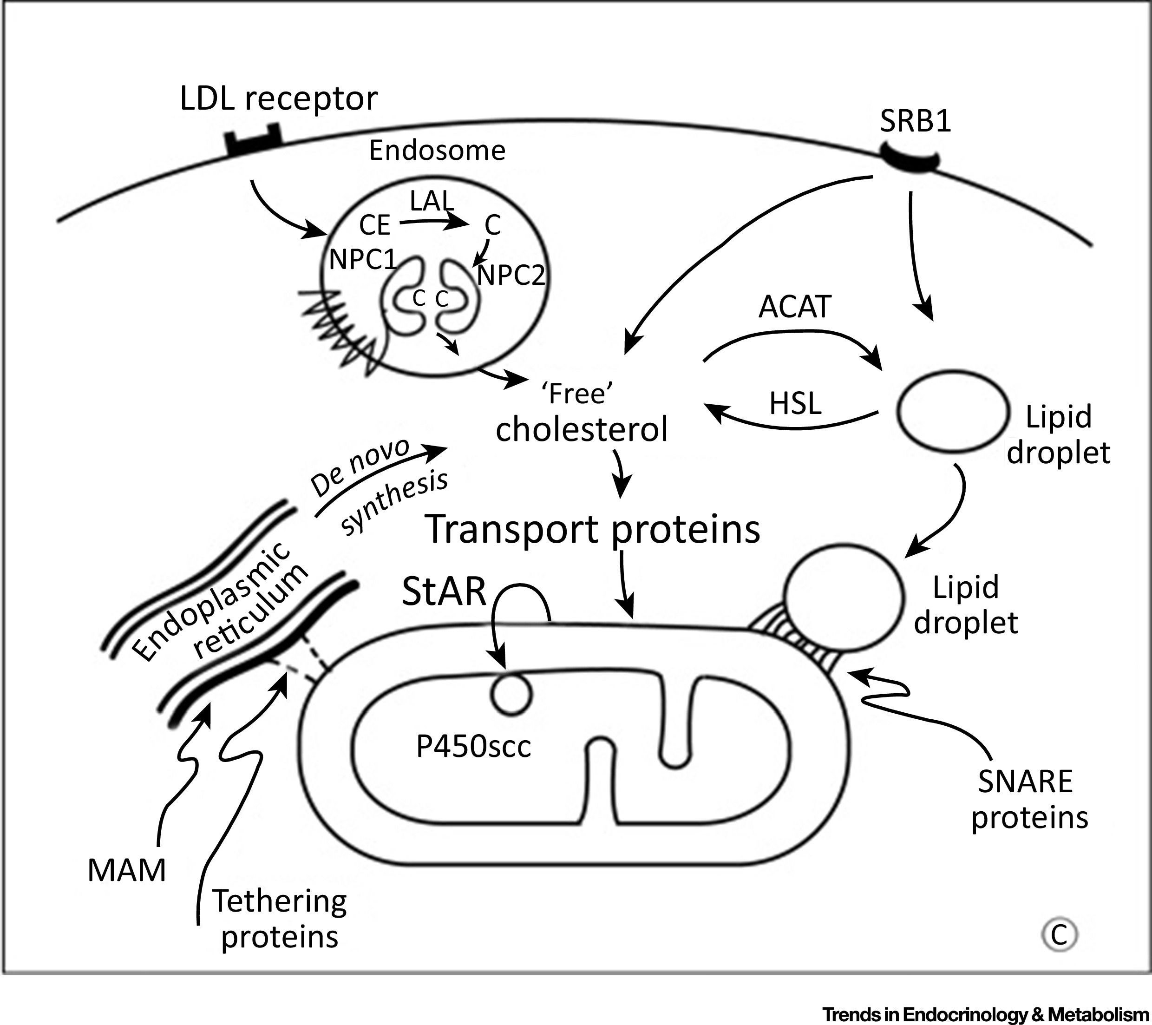
What role does cholesterol play in progesterone synthesis?
IDL
LDL
LIPC
(SREBF1)
(LIPA)
(SOAT1)
(LIPE)
Progesterone Synthesis

Slide 13
What role does hepatic lipase play in progesterone synthesis?
IDL
LDL
LIPC
Interacts With
Catalyzes Step

Slide 14
What do we know about LIPC and reproduction?
ΔLIPC mice have reduced reproductive potential
Truncated form is expressed in the ovaries
Interacts with progesterone synthesis players

Slide 15
What do we have to learn?
ΔLIPC mice have reduced reproductive potential
Are there functional differences between full length and truncated LIPC?
Truncated form is expressed in the ovaries
What is the role of LIPC in reproduction?
Interacts with progesterone synthesis players
How is LIPC involved in progesterone synthesis?

Slide 16
HYPOTHESIS: What is the role of LIPC in reproduction?
IDL
LDL
Full Length LIPC
Truncated LIPC
Progesterone Synthesis

Slide 17
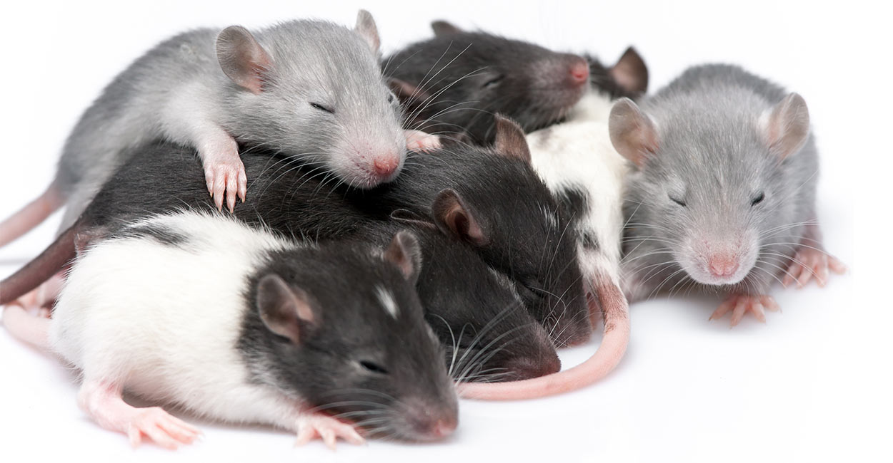
How can we study LIPC?
Notes:
Study HLD’s effect on reproduction using rats.
Rat granulosa cells have the same preferences for cholesterol substrates as humans.
Progesterone levels can be checked by blood test.
Combination of human cell culture and live rat models.

Slide 18
Why are rats good for studying LIPC?
Notes:
Study HLD’s effect on reproduction using rats.
Rat granulosa cells have the same preferences for cholesterol substrates as humans.
Progesterone levels can be checked by blood test.
Combination of human cell culture and live rat models.

Slide 19
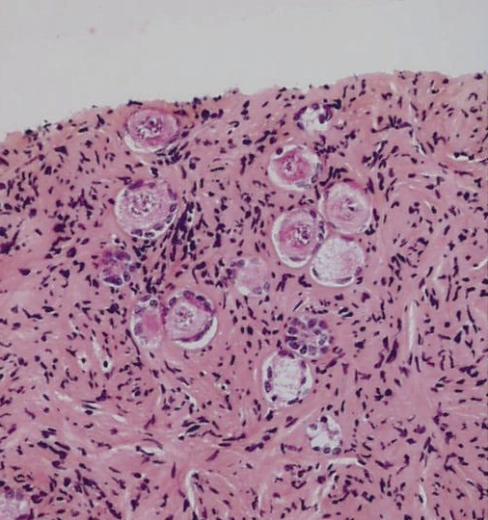
How can we study hepatic triacylglycerol liapse?
Notes:
Combination of cell culture and live rat models.

Slide 20
AIM 1: Identify differences between intracellular truncated LIPC and extracellular LIPC
Domain Analysis
Fluorescence Microscopy
LIPC Mutant Rats

Slide 21
AIM 1: Identify differences between intracellular truncated LIPC and extracellular LIPC
Domain Analysis
Fluorescence Microscopy
LIPC Mutant Rats
Notes:
Look for things that are conserved in this region between species. Focus on differences between species with different reproductive systems. Compare region to other similar proteins to find motifs/areas of structural or functional similarity. Lots of different human lipases that are highly similar- should be able to use these to narrow down important amino acids.

Slide 22
AIM 1: Identify differences between intracellular truncated LIPC and extracellular LIPC
Domain Analysis
Fluorescence Microscopy
LIPC Mutant Rats
Notes:
Replace first two exons with a fluorescence reporter. Use fluorescence to gauge localization (see if protein is now intracellular, etc.). Can measure affects on progesterone synthesis or LIPC activity.

Slide 23
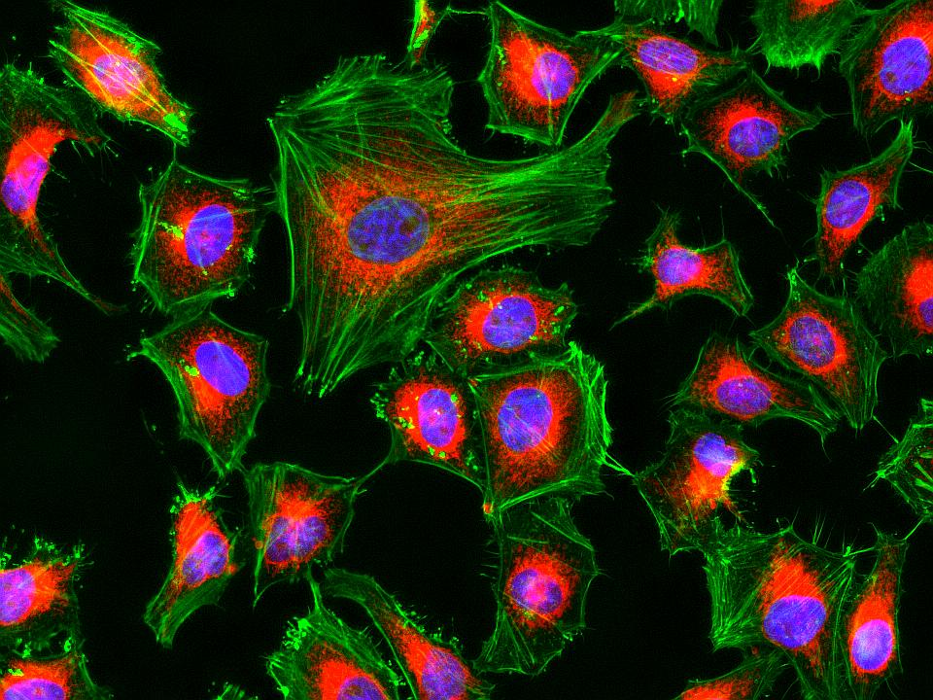
AIM 1: Identify differences between intracellular truncated LIPC and extracellular LIPC
Domain Analysis
Fluorescence Microscopy
LIPC Mutant Rats
Notes:
Replace first two exons with a fluorescence reporter. Use fluorescence to gauge localization (see if protein is now intracellular, etc.). Can measure affects on progesterone synthesis or LIPC activity.

Slide 24
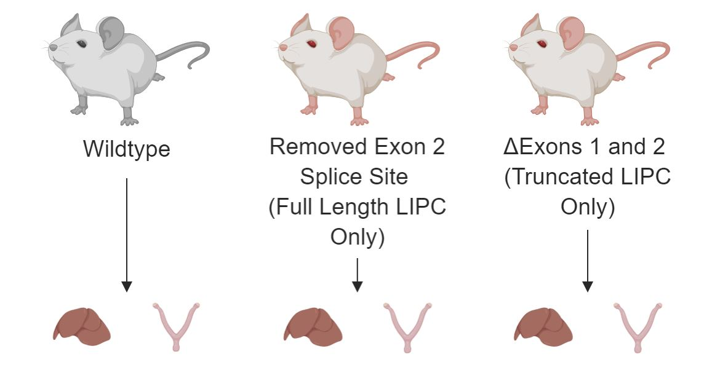
AIM 1: Identify differences between intracellular truncated LIPC and extracellular LIPC
Change in LIPC activity or progesterone levels
Domain Analysis
Fluorescence Microscopy
LIPC Mutant Rats

Slide 25
AIM 2: RNA-seq for altered gene expression in the ovary when LIPC is mutated
LIPC Mutant Rats
RNA-seq
GO Analysis

Slide 26
AIM 2: RNA-seq for altered gene expression in the ovary when LIPC is mutated
Wildtype
Full Length LIPC Only
Truncated LIPC Only
LIPC Mutant Rats
RNA-seq
GO Analysis

Slide 27
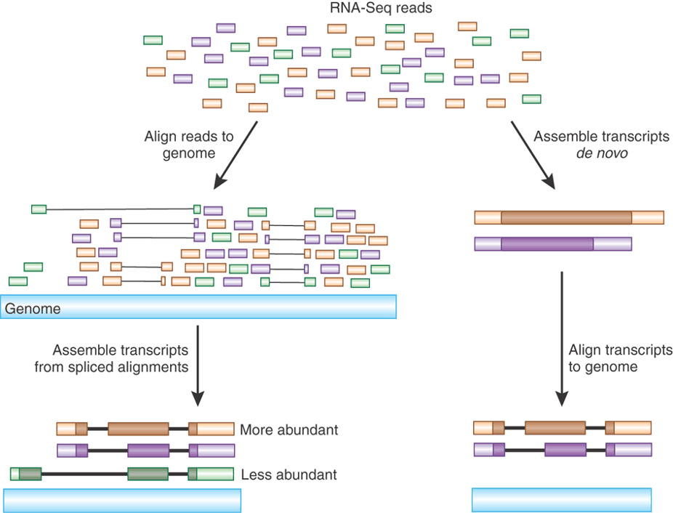
AIM 2: RNA-seq for altered gene expression in the ovary when LIPC is mutated
Wildtype
Full Length LIPC Only
Truncated LIPC Only
LIPC Mutant Rats
RNA-seq
GO Analysis

Slide 28
AIM 2: RNA-seq for altered gene expression in the ovary when LIPC is mutated
LIPC Mutant Rats
RNA-seq
GO Analysis

Slide 29
AIM 3: Analyze proteins that interact with both forms of LIPC
LIPC Mutant Rats
SILAM and Tandem Affinity Purification
Network Analysis

Slide 30
AIM 3: Analyze proteins that interact with both forms of LIPC
SILAM Rat
LIPC Mutant Rats
SILAM and Tandem Affinity Purification
Network Analysis

Slide 31
AIM 3: Analyze proteins that interact with both forms of LIPC
SILAM Rat
Wildtype
Full Length LIPC
Truncated LIPC
LIPC Mutant Rats
SILAM and Tandem Affinity Purification
Network Analysis

Slide 32
AIM 3: Analyze proteins that interact with both forms of LIPC
SILAM Rat
Wildtype
Full Length LIPC
Truncated LIPC
Mix Lysates with SILAM Lysate
LIPC Mutant Rats
SILAM and Tandem Affinity Purification
Network Analysis

Slide 33
AIM 3: Analyze proteins that interact with both forms of LIPC
SILAM Rat
Wildtype
Full Length LIPC
Truncated LIPC
Mix Lysates with SILAM Lysate
Purify LIPC
LIPC Mutant Rats
SILAM and Tandem Affinity Purification
Network Analysis

Slide 34
AIM 3: Analyze proteins that interact with both forms of LIPC
SILAM Rat
Wildtype
Full Length LIPC
Truncated LIPC
Mix Lysates with SILAM Lysate
Purify LIPC
Mass Spectrometry
LIPC Mutant Rats
SILAM and Tandem Affinity Purification
Network Analysis

Slide 35
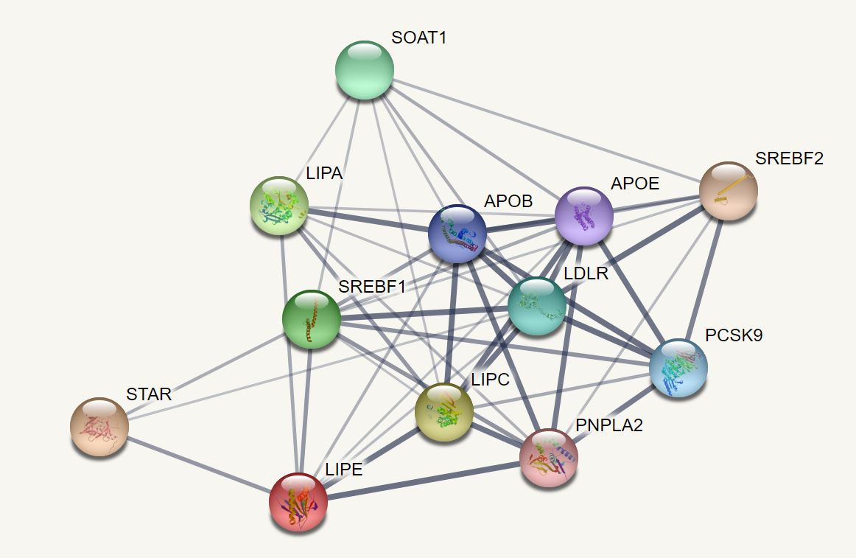
AIM 3: Analyze proteins that interact with both forms of LIPC
LIPC Mutant Rats
SILAM and Tandem Affinity Purification
Network Analysis

Slide 36
Summary
Hepatic Lipase Deficiency (HLD) is caused by mutations in LIPC.
In addition to increasing serum lipid levels, lowered LIPC activity may reduce reproductive potential.
The role LIPC plays in reproduction must be further explored to properly treat HLD patients.

Slide 37
References
[1] https://www.suppreviewers.com/ingredients/lipase/
[2] https://www.uniprot.org/uniprot/P11150
[3] https://www.sciencedirect.com/science/article/pii/S0031302518305713#fig1
[4] https://www.everydayhealth.com/type-2-diabetes/diet/can-eating-too-much-sugar-cause-diabetes/
[5] https://thecostaricanews.com/know-low-progesterone/
[6] https://www.gutmicrobiotaforhealth.com/en/bacterial-butyrate-prevents-atherosclerosis-by-maintaining-gut-barrier-function-in-mice/
[7] https://www.cell.com/trends/endocrinology-metabolism/fulltext/S1043-2760(17)30113-3
[8] https://squeaksandnibbles.com/baby-rats/
[9] https://www.researchgate.net/figure/In-vitro-culture-of-human-ovarian-tissue-a-Freshly-collected-and-fixed-ovarian-tissue_fig7_11494863
[10] https://www.researchgate.net/figure/Mechanism-of-LOO11-GFP-GFP-1-10-as-an-in-vivo-solubility-indicator-for-proteins-tagged_fig5_261634622
[11] https://www.aatbio.com/products/cell-navigator-mitochondrion-staining-kit-nir-fluorescence
[12] https://www.nature.com/articles/nbt0510-421

